Slide 1
ServiceNow Data Replication with MySQL
Designed By : Jitendra Singh Sisodia

Slide 2
OVERVIEW
1
SNOW INTEGRATION
2
DELIVERABLES
3
LOGICAL ARCHITECTURE
4
REQUIREMENTS
5
EXPECTATION FROM CUSTONER
6
ASSUMPTIONS

Slide 3
Overview
Automated scheduler Job will be able to connect to ServiceNow instances (ServiceNow's Rest APIs) to fetch incident data on a specific date range.
Built-In Analyzer logic will apply necessary rules and analysis on the incidents and will arrive at required solution template in a predefined manner.
Data will be loaded in to local/remote systems on periodically basis (will define data load frequency later), once data arrives at destination, analysis logic will be supplied and will provide necessary inputs in the analyzer.
Once filtered data is ready, based on requirement plan, we can send Automated Email report/Self service BI Portal.

Slide 4
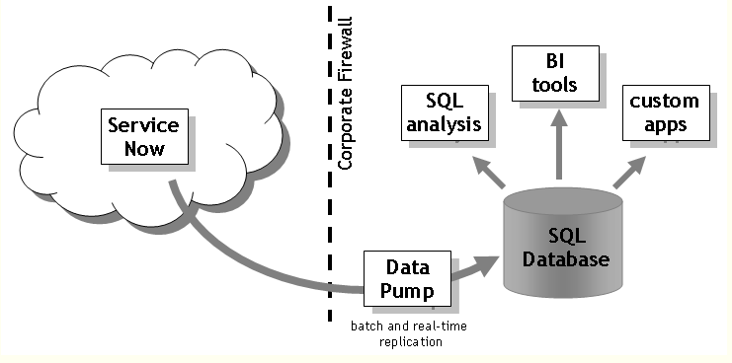
Integration Logical Architecture
Access via REST & SOAP API to Read Incident Tickets

Slide 5
Methodology of Reporting
For reporting purpose , we need specific set of Roles on ServiceNow tables/modules
Data will be fetched & Stored in local/remote machine via Rest & SOAP URLs from ServiceNow
Data fetch frequency can be daily/weekly/monthly or on basis of requirement, can be changed whenever needed
Reporting tool will fetch data from local/remote Datawarehouse and will prepare report as per the given required inputs
Filtered data can be projected at any platform or it may be sent via scheduled email reporting jobs

Slide 6
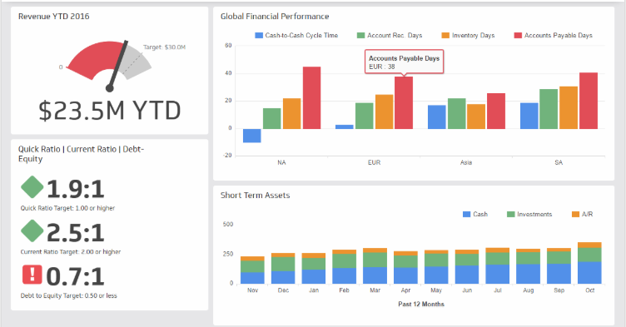
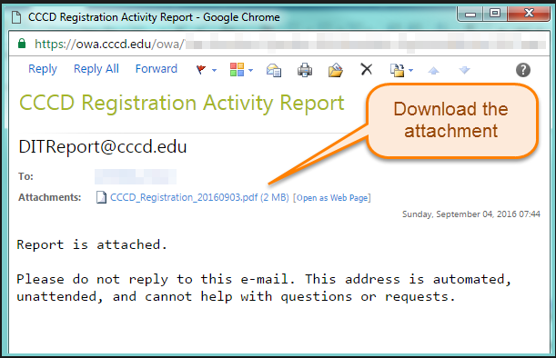
Reporting Formats
Online Dashboards & Reporting Platform
Email Reports
AND/OR
* We support both solutions for our reporting purpose

Slide 7
Requirement
## | Type | Category | Requirements
1 | Account | User | A dedicated user account with access in ServiceNow production infra
2 | Role | soap_query | User's role should include soap_query role (it is read only access)
3 | Role | rest_api_explorer | User's role should have rest_api_explorer role (it is read only access)
4 | Role | rest_services | User's role should have rest_services role (it is read only access)
5 | ACL | Table/Modules Read | User should have Read access on incident, problem, change, task
6 | Group | Database | User's role should be a part of Database group
9 | ACL | sys_db_object | User's role should have Read permission on sys_db_object
10 | ACL | sys_db_object.* | User's role should have Read permission on sys_db_object.*
11 | ACL | sys_dictionary | User's role should have Read permission on sys_dictionary
12 | ACL | sys_dictionary.* | User's role should have Read permission on sys_dictionary.*
13 | ACL | sys_glide_object | User's role should have Read permission on sys_glide_object

Slide 8
Expectation from Customer
EXPECTATION FROM CUSTOMER | MEASURE OF SUCCESS
A user account with access to the production infra to fetch incident details. User should also have access to ServiceNow's table APIs, Soap and Java APIs. | User account with basic authentication should be success while accessing
Permissions are required to Access API, extract incidents via API. | Should be able to connect to different table APIs without any permission issues (mostly problem, incident and its dependent/ referenced API tables)
Connectivity will be required from Our environment to the Service Now API's | Should be able to access ServiceNow API from our infra.

Slide 9
Assumptions
User access will be provided with basic authentication enabled for API access
Permission levels to the API URLs and table will not be revoked/changed. API URLs and tables will not get modified. Behavior of methods in ServiceNow stub classes will not changed irrespective of URLs and tables.
An uninterrupted connectivity will be there from our premises to customer ServiceNow infra provided all valid access credentials.

Slide 10
Thank You

